Slide 2
Activity:
Divide the Table in 3 Sub-tables.
Clean the data and see whether every rows matches correct data format.
Find the Primary Key of all the tables.
Create relationship.
Create 5 Charts along with 3 slicer.
Format the visuals in fire and ash.

Slide 3
Divide the given Table in 3 Sub tables
Orders Table:
OrderID (Primary Key)
OrderDate
ShipDate
ShipMode
CustomerID (Foreign Key referencing Customers.CustomerID)
ProductID (Foreign Key referencing Products.ProductID)
Sales
Quantity
Discount
Profit
Customers Table:
CustomerID (Primary Key)
CustomerName
Segment
Country
City
State
PostalCode
Region
Products Table:
ProductID (Primary Key)
Category
SubCategory
ProductName

Slide 4
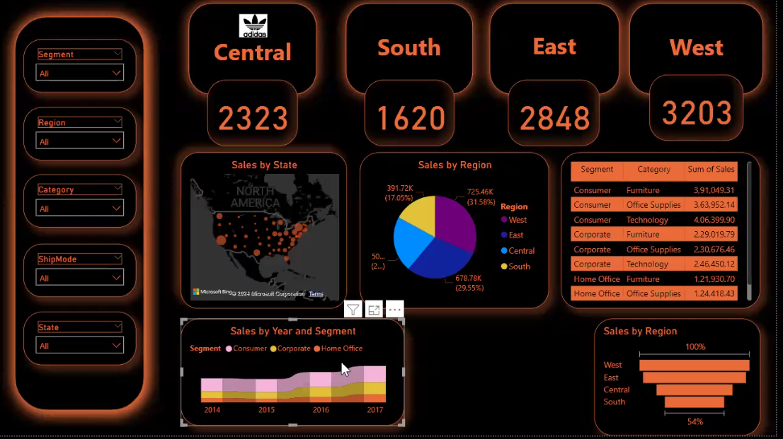
Fire and Ash background

Slide 5
Winners will get:
Team Stood 1st will get 3 chocolates.
Team Stood 2nd will get 2 chocolates.
Team Stood 3rd will get 1 chocolate.

